Slide 1
Competitive Analysis: Portfolios
Jesse Frausto
A08254106
COGS187A

Slide 2
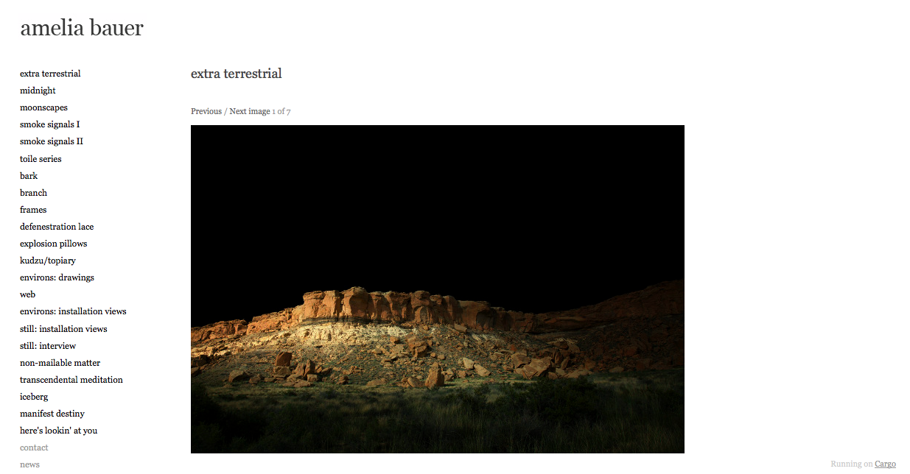
Featured Photo

Slide 3
Featured Photo
Brand | Minimalistic; simple web page, plain text. Less is more? Professional; There is not much flair, all the flair comes from the art displayed Stark; lacks flair but it contrasts hard with the art displayed.
Functionality | This portfolio effectively shows off the pieces of art. The only clickable links are links to different designs and projects on the left of the site. Most of screen real estate is taken up by the featured photo
Interactivity | There is almost zero interactivity on this web portfolio save for simple navigation buttons
Navigation | There is a fixed sidebar on the left-hand side that stays on while searching this portfolio. Excellent navigation between photos.
Amelia Bauer; www.ameliabauer.com; 1/17/12

Slide 4
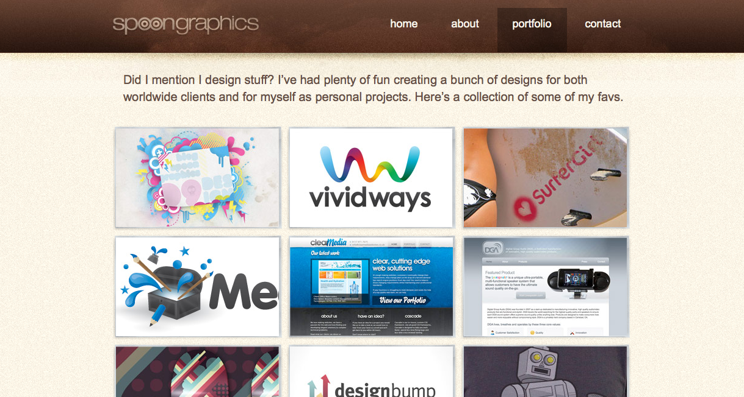
Headline and Gallery

Slide 5
Headline and Gallery
Brand | Fun; almost every design on display has a very colorful, splash to it Childish; very cartoony in the designs Efficient; the way the designs are presented gives me an impression that this portfolio wants to show a lot of designs with very little space
Functionality | The gallery style of this portfolio has high functionality to it, effectively showing off most of the designs and logos from mid sized thumbnails laid out in a grid
Interactivity | Not much interactivity. Once you click one of the thumbnails in the gallery, only an enlarged screenshot appears. Only changing links upon hovering mouse
Navigation | Very straightforward. Does not contain any portfolio navigation besides a standard navigation bar at the top of the site
Spoon Graphics; http://www.spoongraphics.co.uk/portfolio.html; 1/17/12

Slide 6
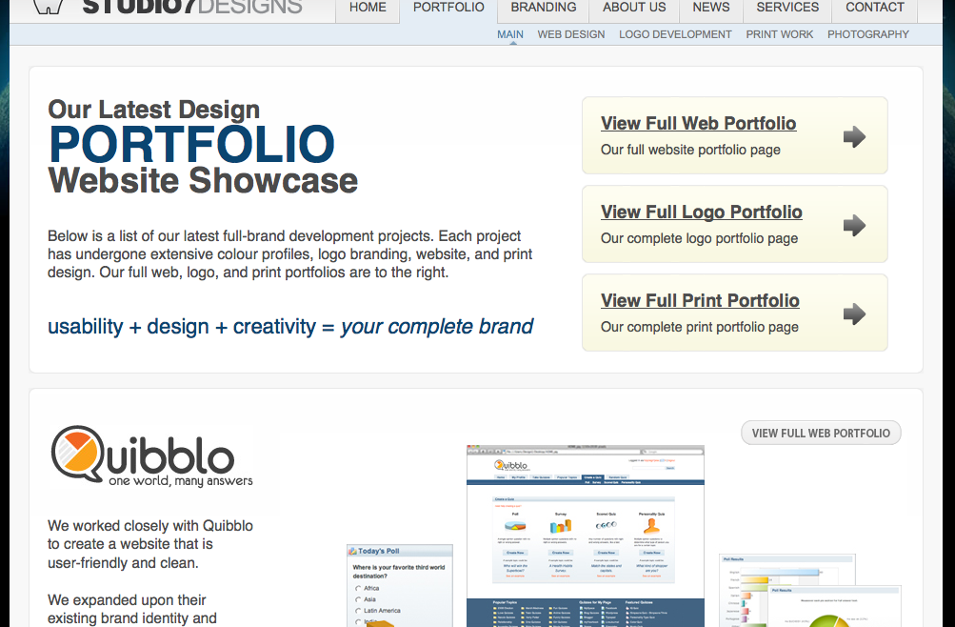
Power Grid

Slide 7
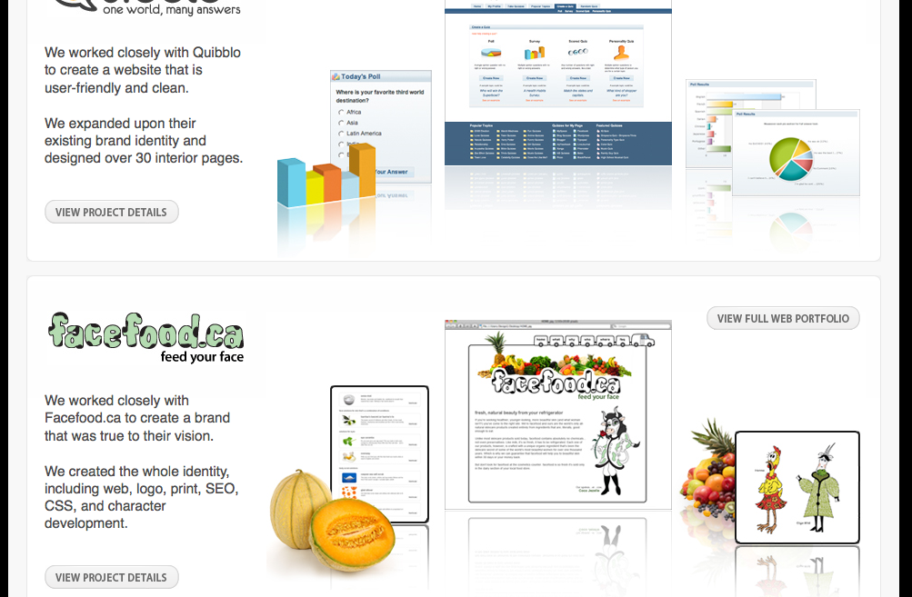
Power Grid
*additional screenshot to show more of portfolio-power grid

Slide 8
Power Grid
Brand | Worldly; the encompassing earth photograph with an extensive portfolio featuring many different logos and brands gives an “all around” impression. It also includes links to OTHER portfolios done by these designers Professional: all images come with a simple description; information packed; b&w Fun; contrasting against the black and white are colorful images of fruits and 3D graphics
Functionality | Somewhat functonal. This portfolio is actually a portfolio of work so extensive that it needs a portfolio on its own. As a result you need to click on a couple of links to get to see more of the designs featured
Interactivity | Almost no interactivity. There are only links to the designs on this site and no way to sort them or really interact.
Navigation | Navigation is sound and has links conveniently next to the designs in the the images as well as a top row navigation bar. The navigation bar itself is very detailed compared to others as it is a double top bar row of links
Studio7 Designs; http://www.studio7designs.com/portfolio/; 1/17/12

Slide 9
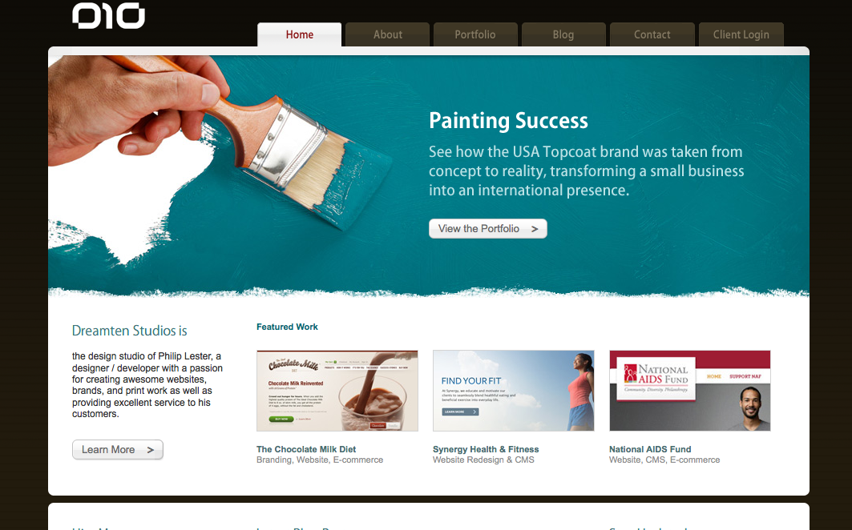
Five Boxes

Slide 10
Five Boxes
Brand | grand; the site eye-catching blue paint says one thing to the audience at first: success on a large scale. Simple; images depicted are done with single object and solid background giving the impression of achieving its purpose with little flair. Professional; not a very flashy site, gets straight to the point with little eye candy
Functionality | I believe this site effectively shows off its old designs and products well, not going under the fold. It could use a bit more text than what is already given next to links in the boxes. If the intent was simplicity it has done that.
Interactivity | There are no options for interactivity on this website save for the links to more information about designs. Simple and clean. This could use some interactivity given the splash of color to make it seem more lively.
Navigation | Very standard top bar navigation. Stays constant at every tab and very well organized
DreamTen; http://www.dreamten.com/; 1/18/12

Slide 11
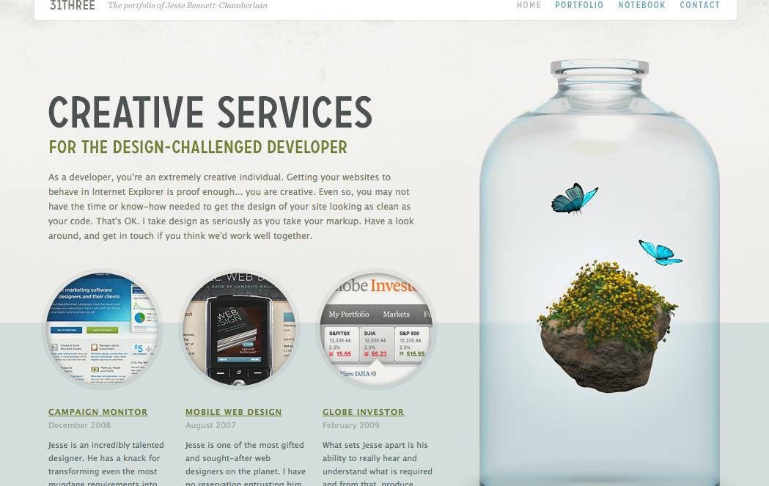
Featured Graphic

Slide 12
Featured Graphic
Brand | Clean; offers a simple service. This message paired with the clear bottle of plain water with surreal elements brings to mind the idea bottled creativity. Clever. Simple; plain site with a large graphic taking up most screen space offering a simple service
Functionality | Very functional for such a site with little going on given the large graphic taking up most space. Simple graphic paired with a simple message seems to work well.
Interactivity | No interactivity. Cannot sort or move elements on this page around in any way. It would have been really cool if the “bottled creativity” could be manipulated on such a nice and large graphic
Navigation | Standard top bar navigational links to contacts and stays constant at every tab. Also has links next to graphic. Simple.
31Three; http://www.31three.com/; 1/17/12

Slide 13
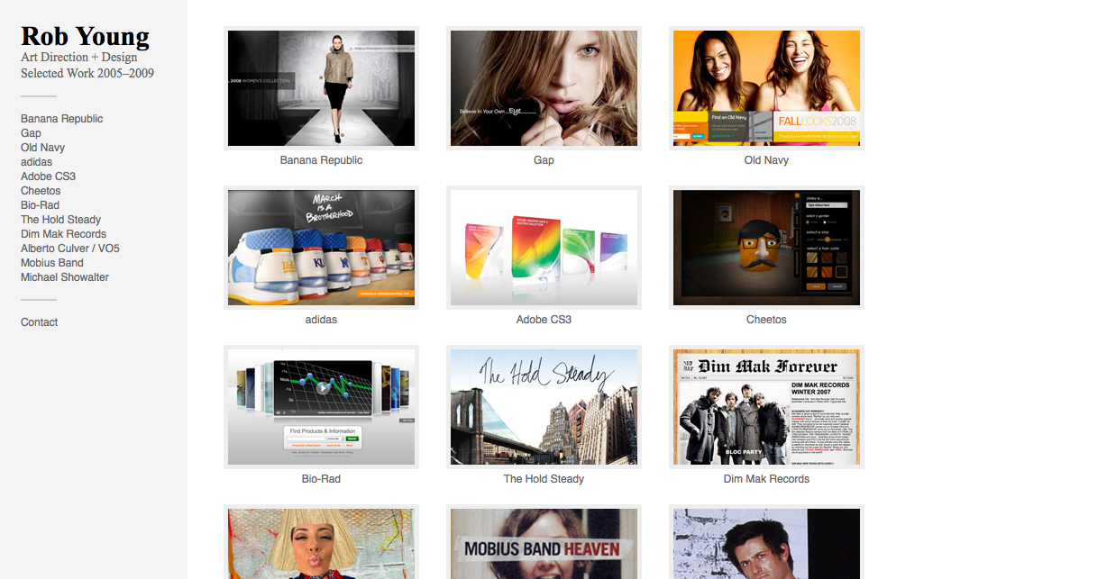
Fixed Sidebar Gallery

Slide 14
Fixed Sidebar Gallery
Brand | Edgy; most of the featured work is very eye catching; a womans gaze, bright colors, models strutting. Not afraid to push boundaries Clear; the portfolio is all white except for the gallery boxes and shows only linked work. Efficient; the only reason to scroll would be to see a little more photos but those links are already all listed out compactly on the left sidebar
Functionality | Very functional. It would have been better to compress the gallery just a bit more to really go with the compact theme. Can find links very easily and speedily.
Interactivity | No interactivity. Links are only thing that user can do. Everything is laid out very clearly from the first load of the site
Navigation | Very clear navigation is aided by the fact that the entire left sidebar is compact and lists out every link there. For added ease, you can also click on the photos to link to the same place that the sidebar links would take you
Rob Young; http://eisforeffort.com/; 1/18/12

Slide 15
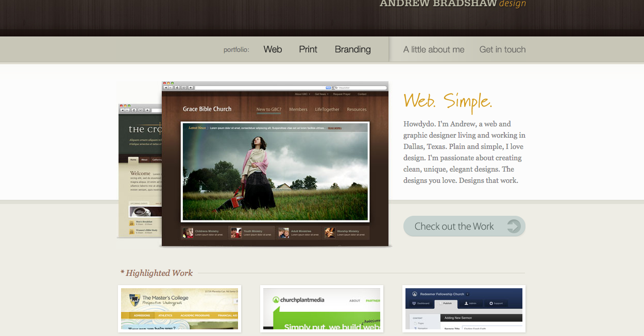
Four Boxes

Slide 16
Four Boxes
Brand | Classic; this portfolio has a simple four box scheme paired with wood finish style on the images and background. Simple; The two first words: “Web. Simple” not flashy practical; some of the featured graphics appear to be personal computer screenshots, which gives me the impression “what you see is what you get” to the audience
Functionality | Not very functional for a simple portfolio. The top navigation bar is far too long and cuts out the bottom three boxes and therefore leaves some info out under the fold
Interactivity | No interactivity, no flashy html. Site claims to be simple and does just that.
Navigation | Standard top navigation bar with a standard four box layout. Very easy to navigate portfolio.
Andrew Bradshaw Design; http://andrewbradshaw.com/; 1/18/12

Slide 17
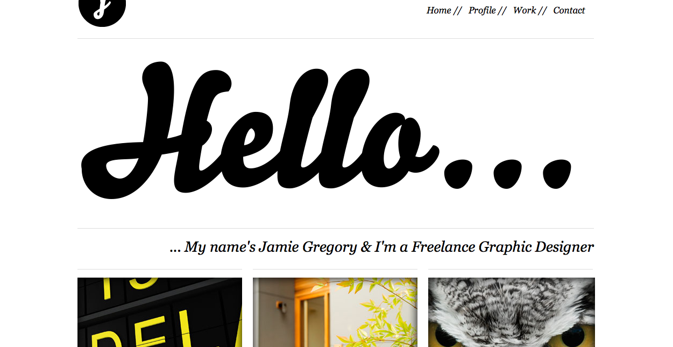
Giant Headline + Boxes

Slide 18
Giant Headline + Boxes
Brand | Clean; strong black and white scheme Minimalistic; has a giant headline saying hello and three box links Childish; designer opts to not include a photo or graphic to catch eye but does the opposite to do so, uses a giant HELLO
Functionality | In its simplistic nature, it does seem to be very effective. Everything is clear, although it could use a bit more words under the giant HELLO as in introduction.
Interactivity | No interactivity but it does have some sort in the form of direct links to social media sites such as twitter and linkedIn
Navigation | There is a top navigation bar and a navigation bar under the three boxes of featured work. The navigation bar should be made larger and more visible but is present always. Nice.
Jamie Gregory; http://jamiegregory.co.uk/; 1/18/12

Slide 19
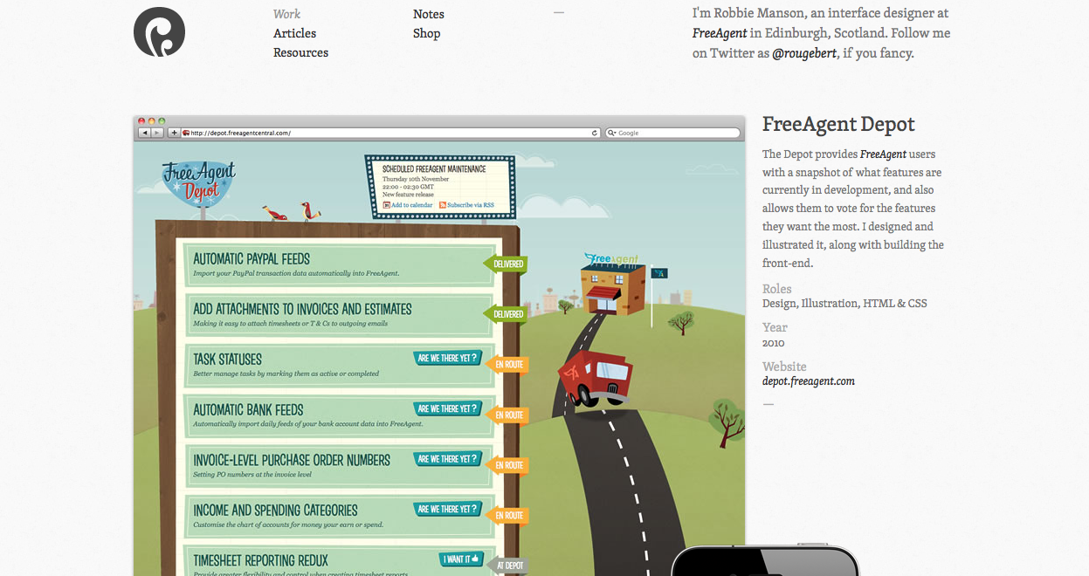
Screenshot Gallery

Slide 20
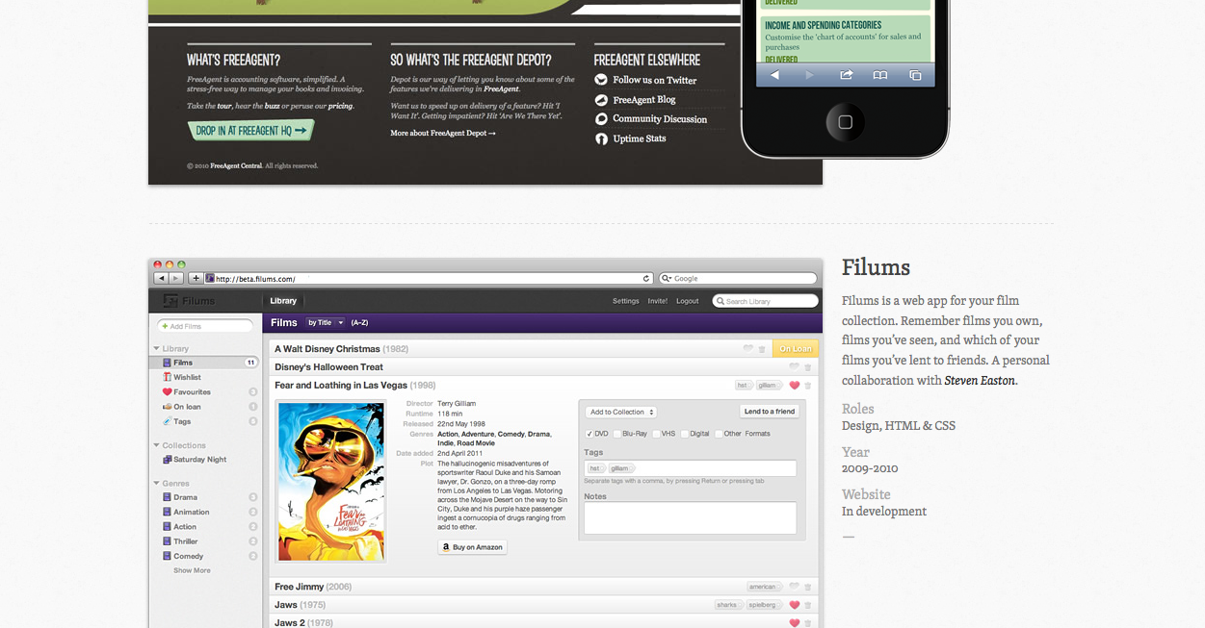
Screenshot Gallery

Slide 21
Screenshot Gallery
Brand | Brainy; claims specialty in UI design and shows a LOT of screenshots of Uis. Technical; goes right into description of other companies and interfaces designed Practical; by showing full sized screenshots from a personal computer, the entire interface can be shown, achieving a full bodied feel of what the designer can do
Functionality | Somewhat functional. Seems like a detail-oriented designer so the details are displayed nicely with each example of work but images are too large. Audience needs to scroll a lot of see most of work AND contact information.
Interactivity | Only interactivity is made when clicking on a link; a subtle button press animation. Needs more interactivity in the form of cover-flow to efficiently show large screenshots
Navigation | So-so. Navigation bar stays at the top when clicking around but need to scroll way down to find contact info
Robbie Manson; http://www.robbiemanson.com/; 1/18/12

Slide 22
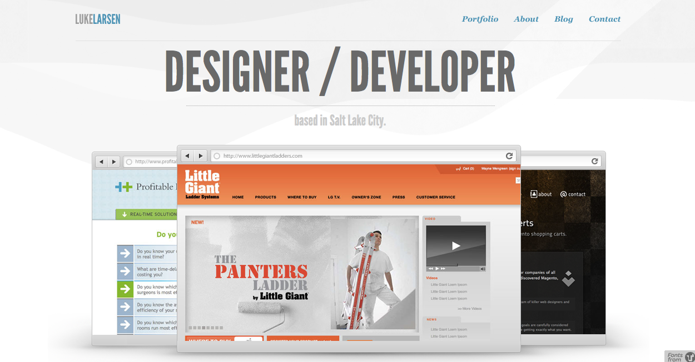
3D Layout

Slide 23
3D Layout
Brand | Modern; this portfolio features a 3D display of screenshots Simple; two most important things on page seem only to be the screenshots and the title Professional; includes an explicit “what I do” and “why hire me” sections below the fold. This portfolios gets straight to the point and does not bother to embellish.
Functionality | The designer could have made the large font smaller to include more important text at the bottom move up and maybe over the fold. Links are all clear. Somewhat functional
Interactivity | No interactivity in the portfolio. I should have chosen more interactive portfolios. Only links to recent articles and navigation seem to involve the user here.
Navigation | Very nice use of a fixed top navigation bar since there is information under the fold that contain useful links. Very good.
Luke Larson; http://lukelarsen.com/; 1/19/12

